Slide 1
FRAUD RECRUITMENT DETECTOR: Identifying False Job Postings Using Machine Learning Classification Methods
Team Members: Prachi Dixit, Kartik Goyal
University: VIT University

Slide 2
Data Set
For this project, I used a Kaggle Dataset of Job Postings: https://www.kaggle.com/shivamb/real-or-fake-fake-jobposting-prediction/data#
This is a supervised learning task so the data contains the binary target class labels.
Data contains 18k job postings, of which about 800 are labeled as fake.
This dataset contains 18 features (columns) including the target class label.

Slide 3
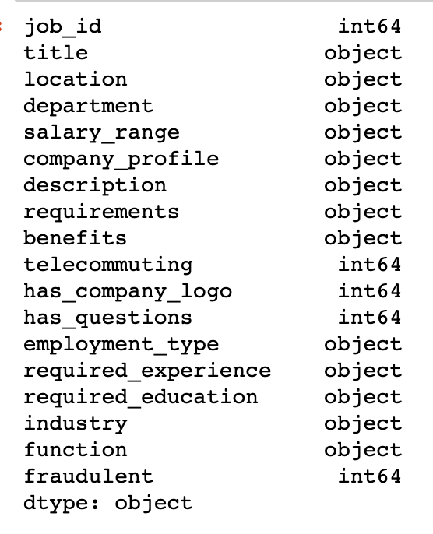
EDA/Data Preparation
This dataset is is almost entirely consisting of categorical features of object type. The few numeric features are Boolean representations of the data.
There we no duplicate values in the dataset.
There were a number of missing values identified in some of the columns which I had to handle.

Slide 4
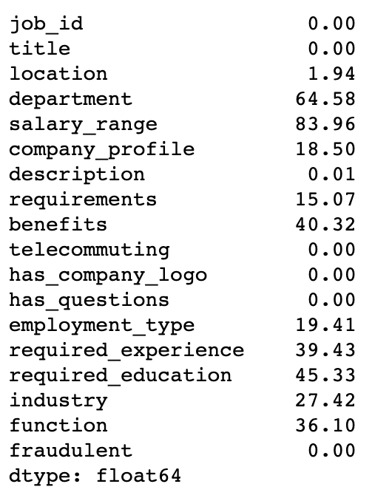
Handling Missing Values in the data
The column ‘salary_range’ had > 80% missing data, so I dropped it from the data set.
The remaining categorical columns with missing values appeared to be missing at random (MAR); so I decided to bucket the missing values into a new category.
Where possible I re-used existing categories such as ‘N/A’ or ‘Other’ to bucket the missing values.

Slide 5
Visualizing the Data
The data set is highly imbalanced with very few fake job postings, which reflects real-world conditions (hopefully!) but it is still helpful to know if there are any natural correlations present in the data that I could identify.
By plotting some of the values I could determine that certain features such as the required education, the type of job, and duration of the job ( full time, part time, etc.) had higher correlation with the class label of fraudulent.
Later, I could see some of these correlated feature values were selected as having some weighted importance by the learning algorithm.

Slide 6
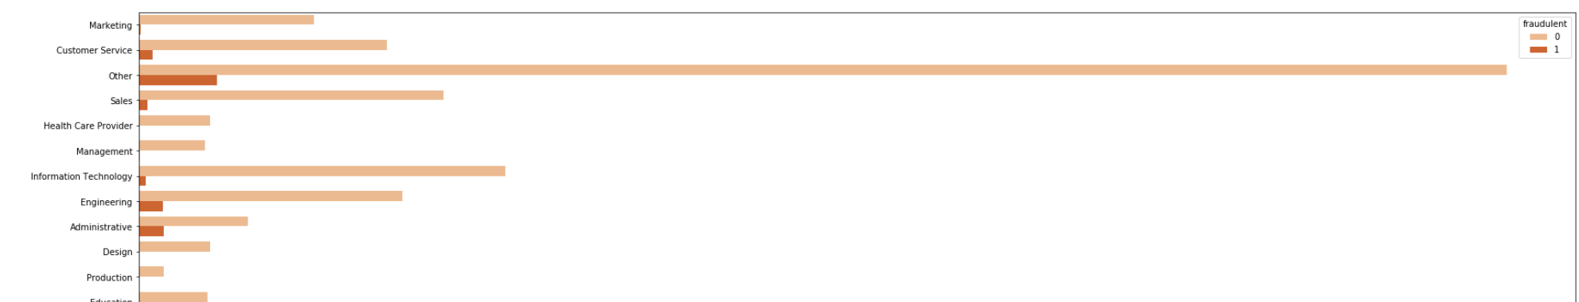
Job Postings Categorized as Engineering, Administrative have higher instances of fraudulent postings:

Slide 7
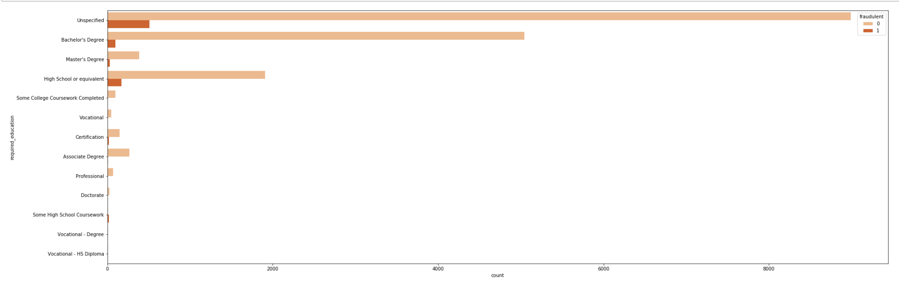
Jobs Postings Requiring a High School Diploma or Bachelors Degree have higher instances of fraudulent postings:

Slide 8
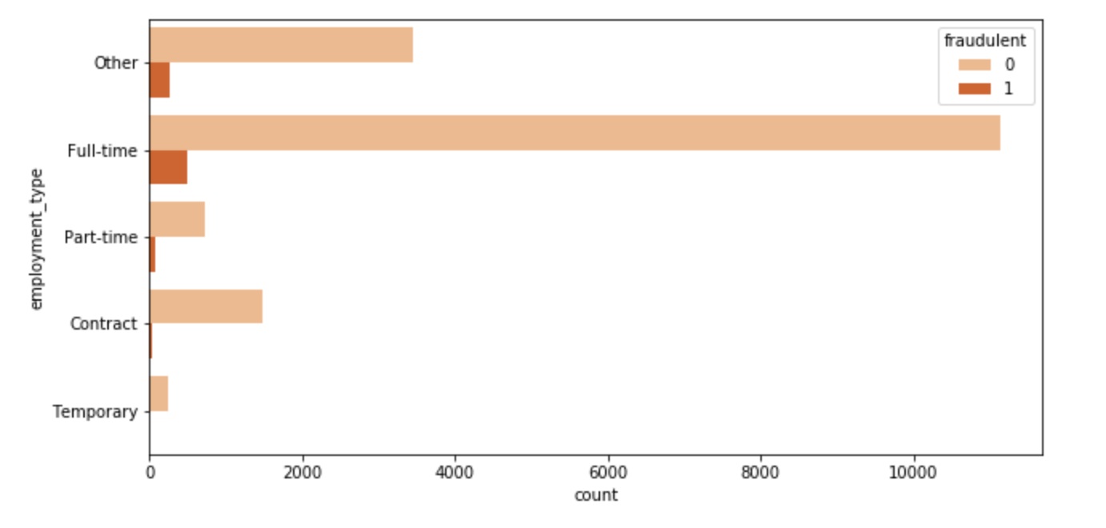
Jobs Postings which are of the type Full-time have higher instances of fraudulent postings:

Slide 9
Model Training and Evaluation
For this project, I chose to train and evaluate the following machine learning models:
Random Forest Classifier
K Nearest Neighbors Classifier
Decision Tree Classifier

Slide 10
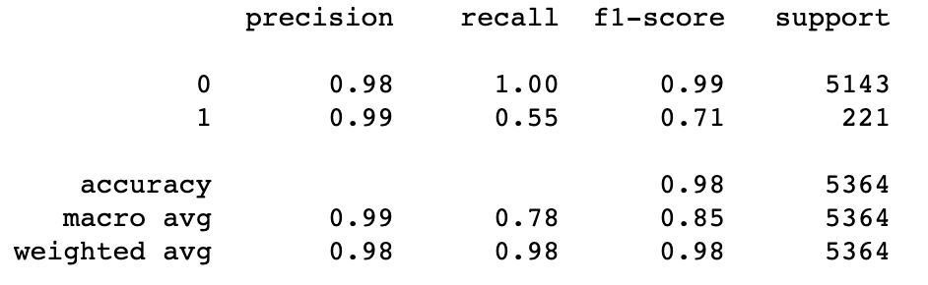
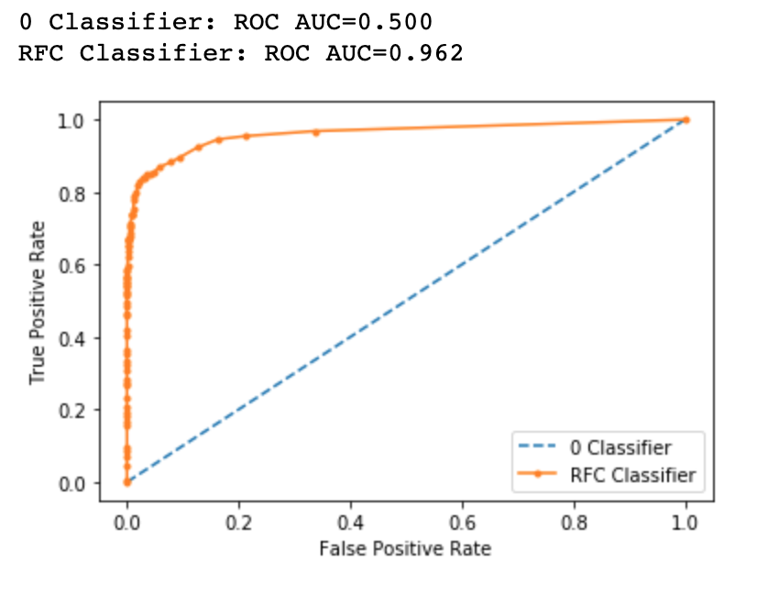
Random Forest Classifier
The Random Forest model achieved a weighted avg accuracy score of 98%
When compared to an unskilled model (that always picks 0) the RFC Classifier has area under curve as 0.962.
The most important feature to inform this model was ‘has_company_logo’.
Using a combination of ShuffleSplit and KFold Cross validation with below params achieved similar accuracy +- 1%:

Slide 11
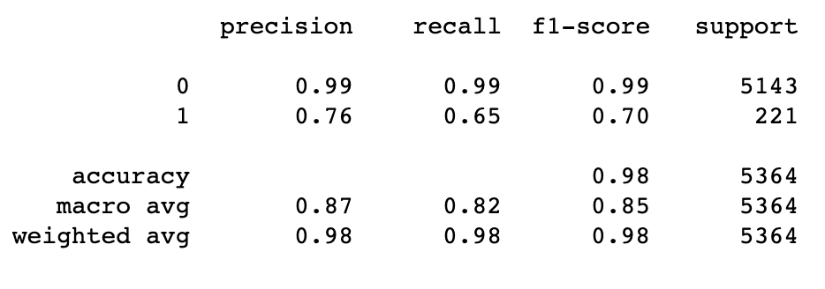
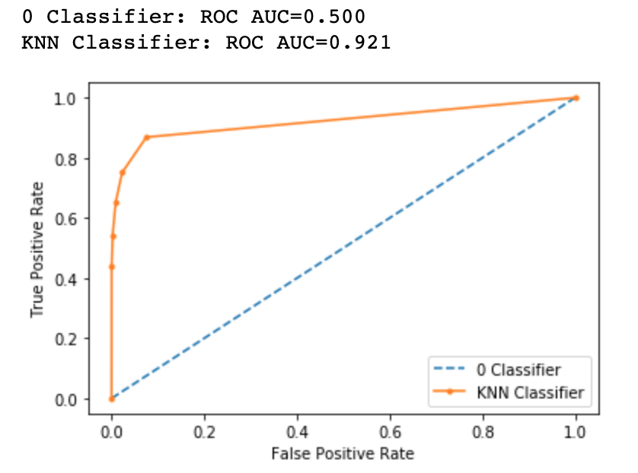
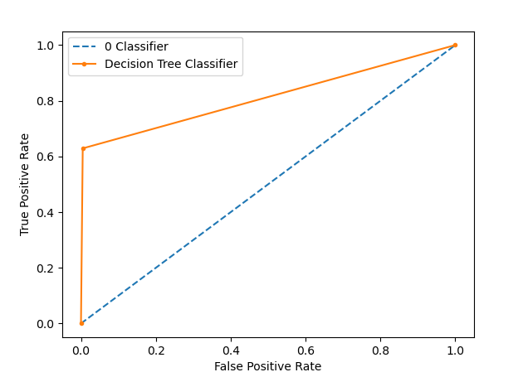
K Nearest Neighbors Classifier
The K Nearest Neighbors Classifier achieved a weighted avg accuracy score of 98%.
When compared to an unskilled model (that always picks 0) the KNN Classifier has an AUC of 0.921 compared to the unskilled model at 0.50
Unlike RFC KNN does not have a built-in way to identify the relative feK ature importance.
For my model, I set the value of = 5, which was a good tradeoff of accuracy to execution time. As the K reduces, the predictions become less stable, but as K increases the execution time becomes extremely slow.

Slide 12
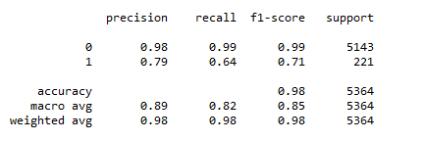
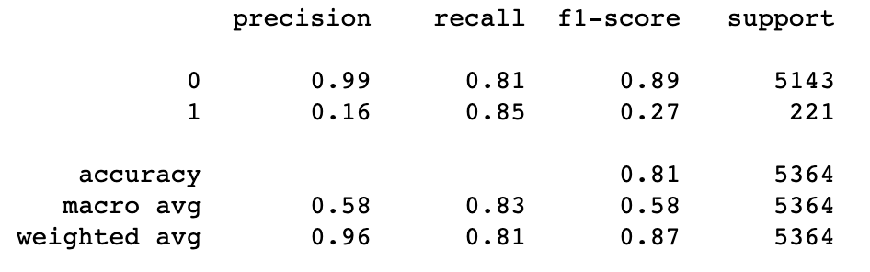

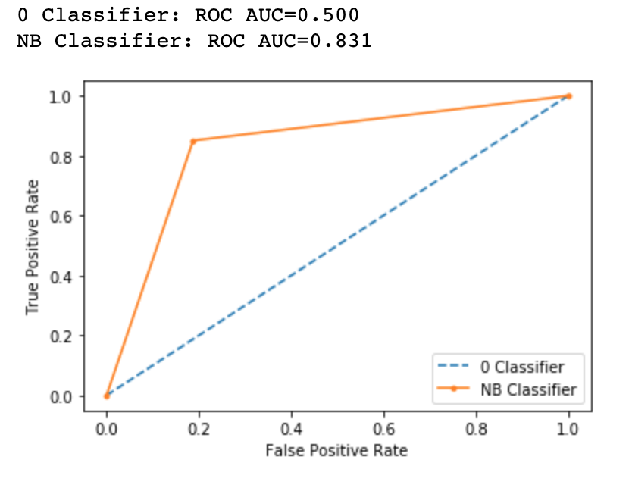
Decision Tree Classifier
The Decision Tree Classifier achieved a weighted avg accuracy score of 98%.
This model achieves a lower AUC of 0.81 (relative to the other ML classifiers) when compared to the 0 Classifier model AUC of 0.50.
Decision Tree is performance is not better than Random Forest and K Nearest algorithm Classifier because of less AUC score.

Slide 13
Comparing Classifier Prediction Accuracy
Model Name | Precision | Recall | F1 | Hyperparameters
Random Forest | 99% | 78% | 85%
K Nearest Neighbors | 87% | 82% | 85%
Decision Tree | 89% | 82% | 85%

Slide 14
Conclusions
The ensemble learning methods (Random Forest) achieved the highest levels of classification accuracy of the several models I trained on this data set. I speculate this is because many of the original categorical features have some level of predictive power (as shown in the data visualization portion) and the features are relatively uncorrelated. Ensemble learning methods tends to work well for this type of data.
K Neighbors Classifier also performed remarkably well on this data but had the longest execution times making it difficult to do extensive parameter tuning or experimentation. However the fake and true job ads shared enough similarities in features that the KNN model was still able to perform well given this limitation.
Decision Tree performed is good but not better than other two. Intuitively, we might think it would perform well due to relatively few features in the data set.
Let’s move on to website.

Slide 15
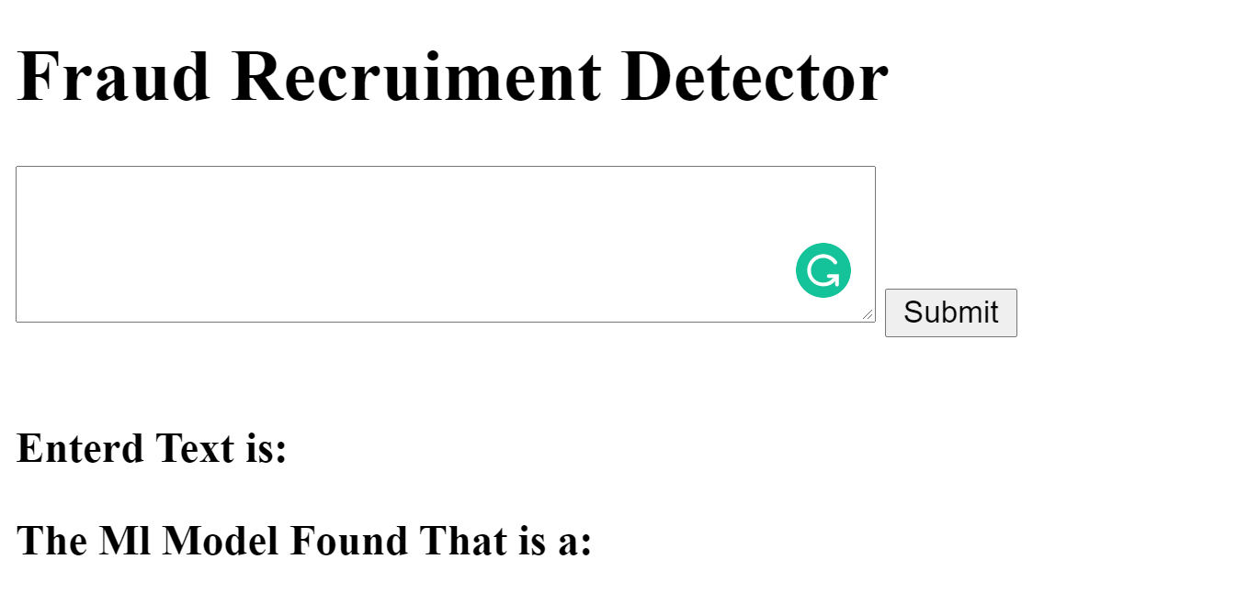
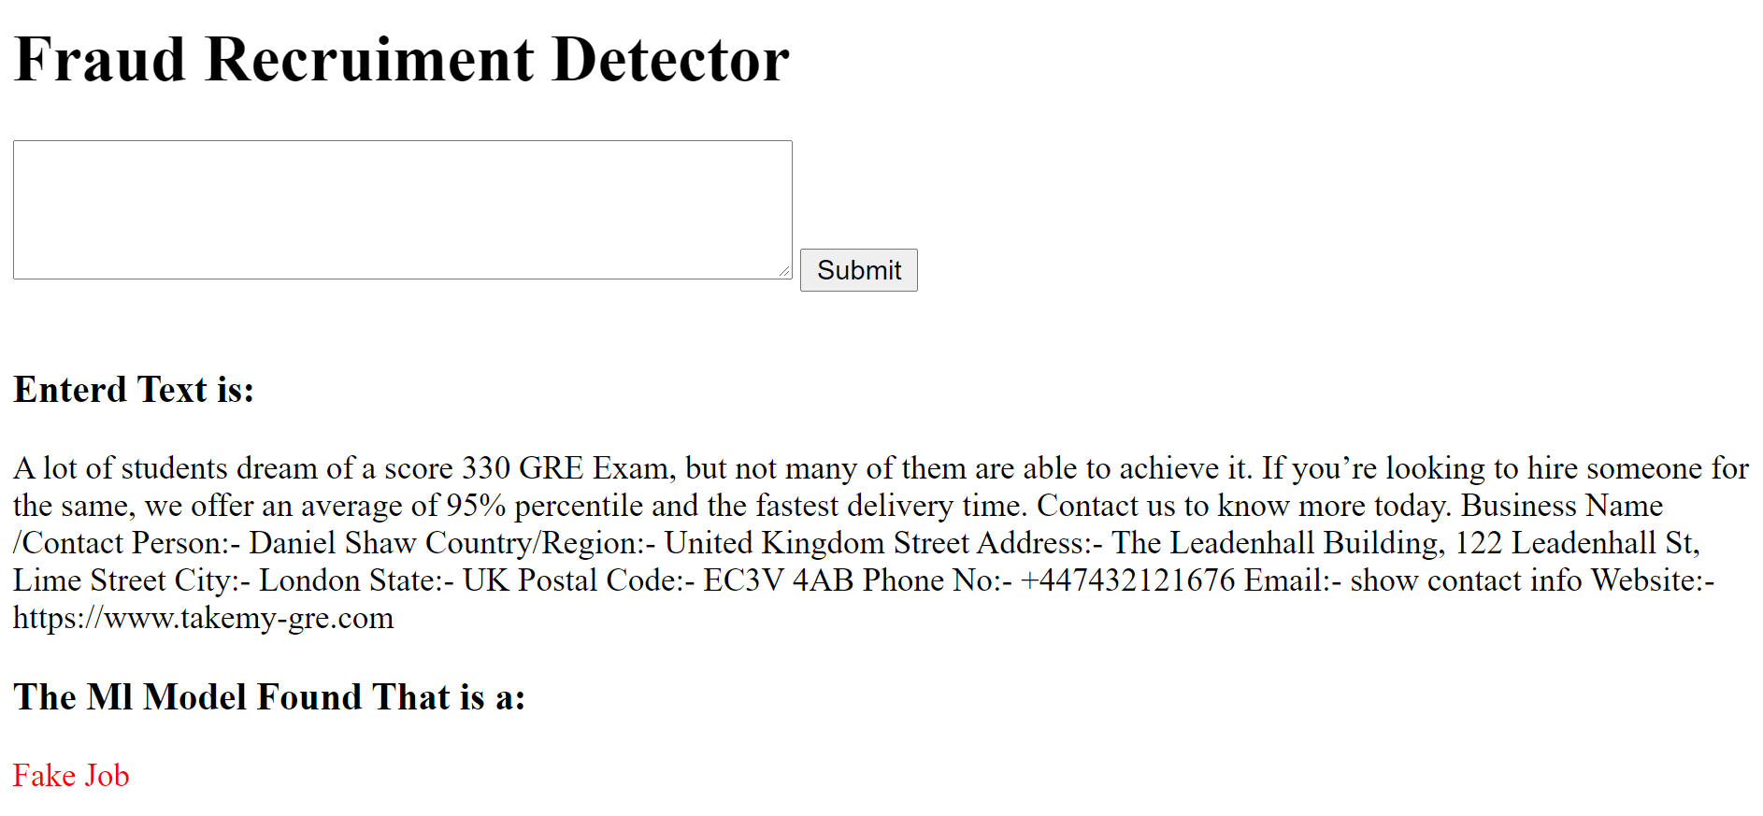
Website Shots

